Slide 1

SHA1 HASHING & ANALYSIS ON COLLISIONS
Nayana D V
Shruti Sharma
Sushma S

Slide 2
Our focus for today
1
Why SHA1?
2
Why we think SHA1 is broken?
3
Understanding the SHA1 hashing algorithm
What is SHA1?
How does SHA1 work?
4
Demo of our Implementation

Slide 3

What is SHA1?
Secure Hash Algorithm 1
Trusted cryptographic one way # function
NSA and NIST designed it and it produces a unique hash value for any input message
Similar to MD5 in design but better. As the name suggests its more Secure than the MD5
Provides Cryptographic Integrity, Strong collision resistance.

Slide 4


Why ?
Most of the protocols that we learnt TLS, SSL, SSH, IPSec are based on SHA1
SHA-1 is used by Digital Signature Standard (DSS), which is a standard used for digitally signing documents.
GIT, Mercurial : Revision
control systems use SHA1 to
detect tampering/corruption
WII uses it for signature
Verification while booting.

Slide 5

How does SHA1 work?
The SHA-1 hash function maps a set of strings of length < 2^64 bits into a finite set of 160-bit hash value
file: avatar.avi
SHA-1
2fd4e1c6 7a2d28fc ed849ee1 bb76e739 1b93eb12
160-bit message digest
40 hex digits
A file composed of n bits

Slide 6
How does SHA1 work?
“The quick brown fox jumps over the lazy dog”
SHA-1
2fd4e1c6 7a2d28fc ed849ee1 bb76e739 1b93eb12
“The quick brown fox jumps over the lazy cog”
SHA-1
de9f2c7f d25e1b3a fad3e85a 0bd17d9b 100db4b3
Just a small change, e.g. from “dog” to “cog”, will completely change the hash value

Slide 7

SHA1 versus MD5
SHA1 | MD5
160 bit digest : Brute force is tougher | 128 bit digest: Brute force is easier
Not vulnerable to known attacks | Vulnerable to known attacks
80 steps : Slower than MD5 | 64 steps : Much faster than SHA1
Optimized for Big Endian CPU’s | Optimized for Little Endian CPU’s
Collisions can be produced but quite tough to do so | Collisions have been found quite easily

Slide 8

Why is SHA1 considered broken?
Claim1: A German hacker claims to have successfully cracked a six-character implementation of the 160-bit SHA-1 crypto algorithm using Amazon cloud computing resource. As he states, the hack was completed in 49 minutes at a cost of just $2.10.
Jon Callas, PGP's CTO, put it best: "It's time to walk, but not run, to the fire exits. You don't see smoke, but the fire alarms have gone off."

Slide 9

Why is SHA1 considered broken?
Claim 2: Eurocrypt 2009 convention: Exploiting the weakness of SHA1, the practical complexity of breaking SHA1 has been reduced to 2^63. (Latest : 2^33)
Attacks can be performed using Computer clusters.
Online SHA1 cracker : http://www.hashkiller.co.uk/sha1-decrypter.aspx
Try with this and it breaks it in
just a matter of a few seconds
'test' => SHA-1 =>
'a94a8fe5ccb19ba61c4c0873d391e987982fbbd3'

Slide 10

Alternatives for SHA1?
SHA2
SHA3
SHA256
SHA1 with salt

Slide 11
SHA1 hashing algorithm
Step 0: Initialize some variables
h0 = 01100111010001010010001100000001
h1 = 11101111110011011010101110001001
h2 = 10011000101110101101110011111110
h3 = 00010000001100100101010001110110
h4 = 11000011110100101110000111110000
Step 1: Pick a string
In this example we use the string: 'A Test'.
Step 2: Break the string into characters

Slide 12
Step 3: Convert characters to ASCII codes
Step 4: Convert numbers into binary
Step 5: Add '1' to the end
Step 6: Append '0's' to the end : Add zeroes to the end until the length of the message is congruent to 448 mod 512
Step 6.1: Append original message length
64-bit representation of the original message length, in binary

Slide 13
Step 7: 'Chunk' the message
Break the message up into 512 bit chunks
Step 8: Break the 'Chunk' into 'Words‘
Break each chunk up into sixteen 32-bit words
Step 9: 'Extend' into 80 words
Step 9.1 : XOR
Step 9.2 : Left Rotate : By a factor of 1
Step 10: Initialize some variables
Set the letters A-->E equal to the variables h0-->h4.
A = h0
B = h1
C = h2
D = h3
E = h4

Slide 14
Step 11: Main functions
Words 0-19 go to function 1. Words 20-39 go to function 2 Words 40-59 go to function 3 Words 60-79 go to function 4
Step 11.1 : Function description
Function1 = (B AND C) or (!B AND D)
Function2 = B XOR C XOR D
Function3 = (B AND C) OR (B AND D) OR (C AND D)
Function4 is same as Function2
Step 11.2: Main functions
(A left rotate 5) + F + E + K + (the current word)

Slide 15

Step 11.3: Reset variables
E = D
D = C
C = B Left Rotate 30
B = A
A = temp
h0 = h0 + A
h1 = h1 + B
h2 = h2 + C
h3 = h3 + D
h4 = h4 + E
Step 12 :
Values from h0 – h4 are converted to base 16 and appended together
Final output for our example
8f0c0855915633e4a7de19468b3874c8901df043

Slide 16
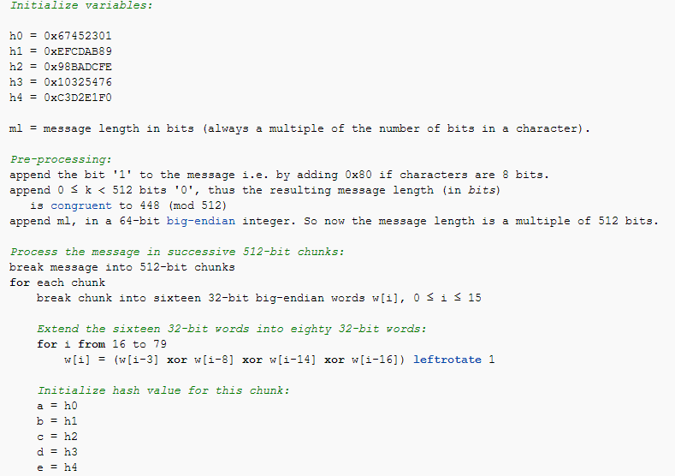

Slide 17
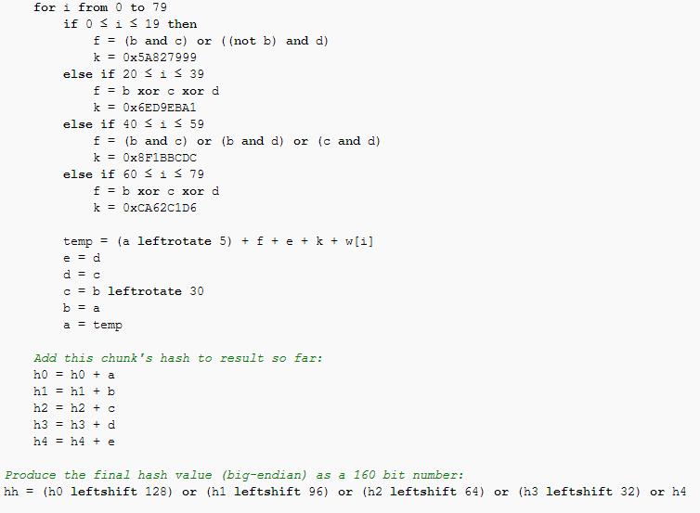

Slide 18
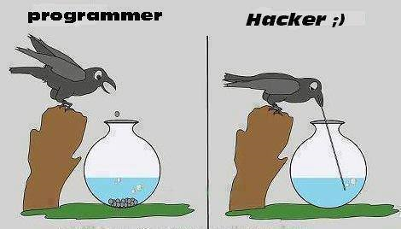
Thank you and keep your files safe!!!

